Slide 1
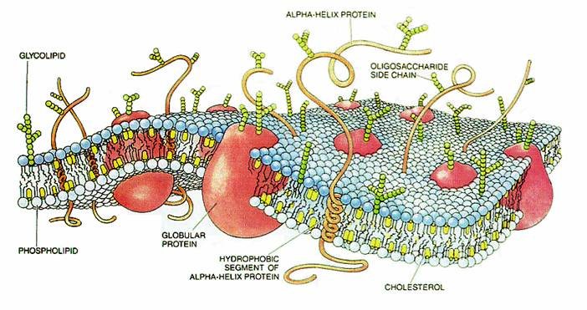
THE CELL MEMBRANE AND ITS FUNCTION

Slide 2
Life at the Edge
The plasma membrane is the boundary that separates the living cell from its nonliving surroundings
The plasma membrane exhibits selective permeability, allowing some substances to cross it more easily than others as they need to obtain nutrients and rid themselves of waste products.

Slide 3
Cellular membranes are fluid mosaics of lipids and proteins
The fluid mosaic model states that a membrane is a fluid structure with a “mosaic” of various proteins embedded in it
Phospholipids are the most abundant lipid in the plasma membrane
Phospholipids containboth hydrophobic and hydrophilic regions

Slide 4
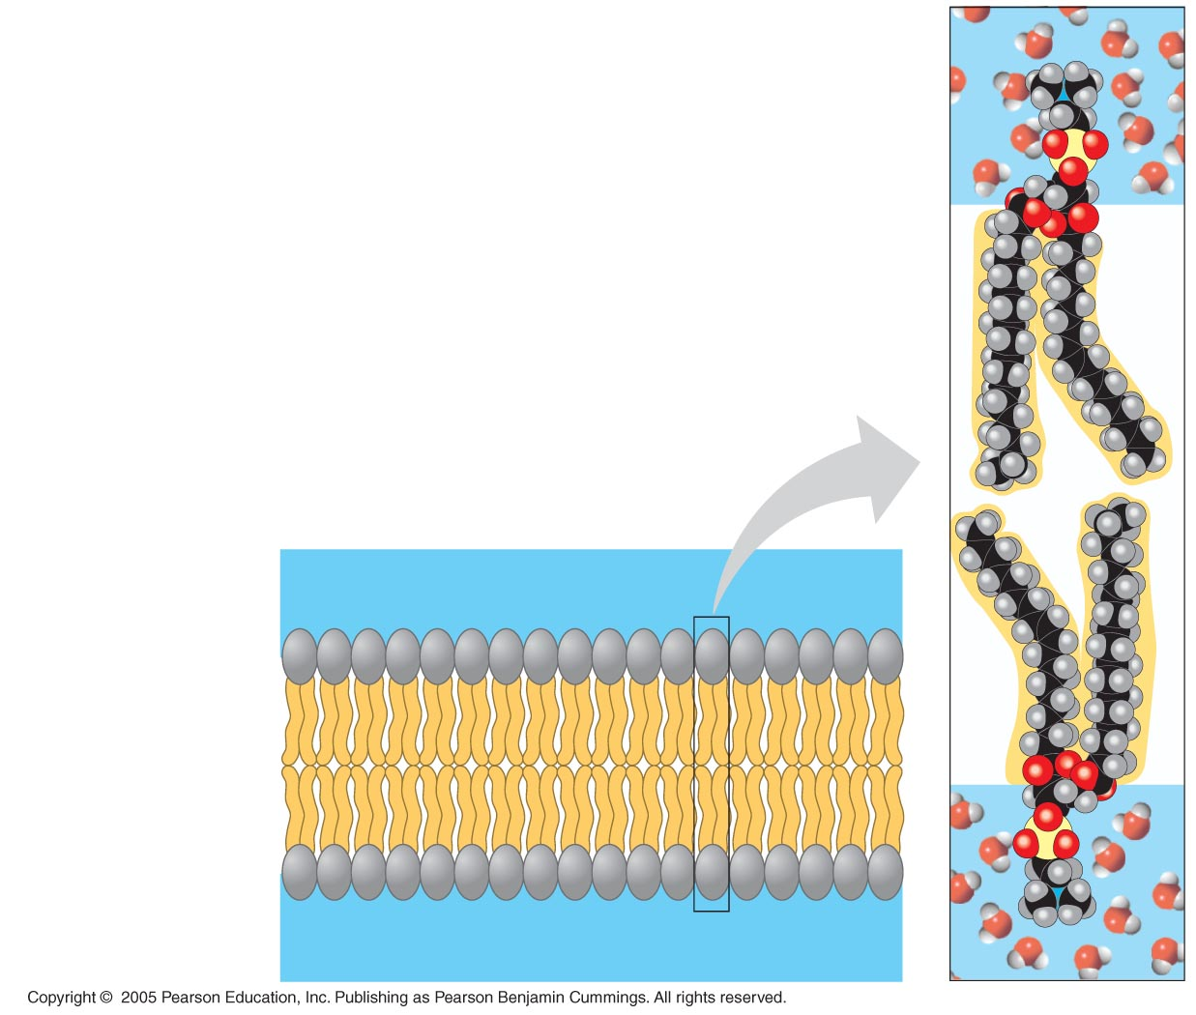
The Cell Membrane
approx. 7.5 nm thick
membrane appears as 2 parallel lines through an E.M.
the 2 layers contain proteins and carbohydrates, but are mainly composed of phospholipids.
WATER
Hydrophilic
head
Hydrophobic
tail
WATER

Slide 5
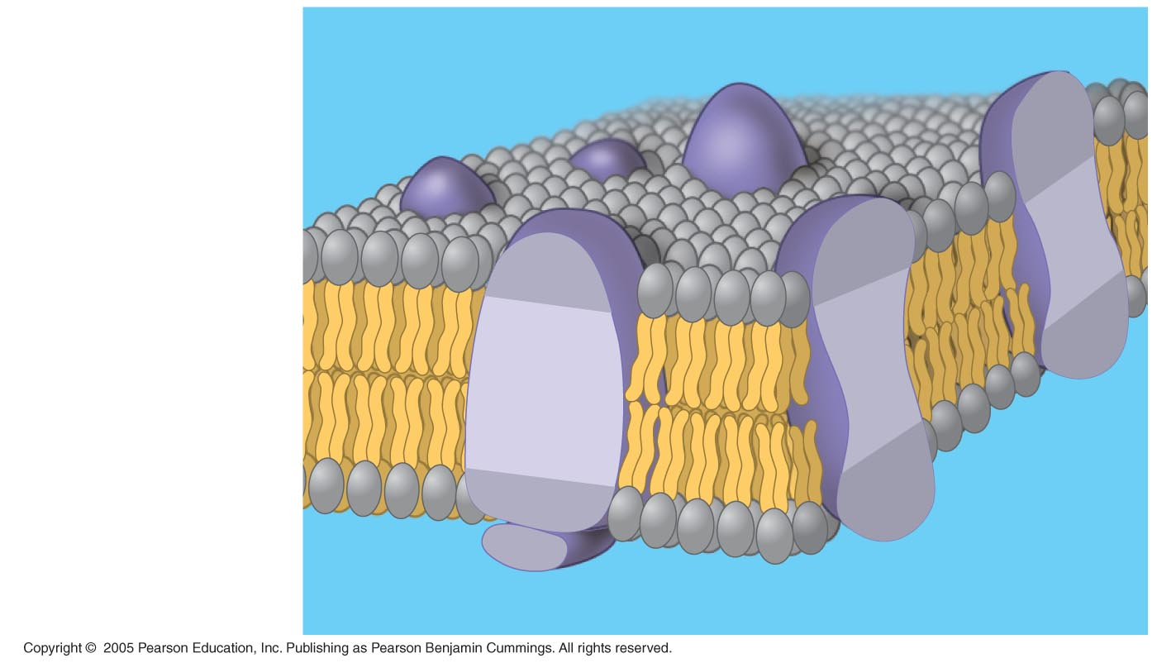
Hydrophilic region
of protein
Phospholipid
bilayer
Hydrophobic region of protein

Slide 6
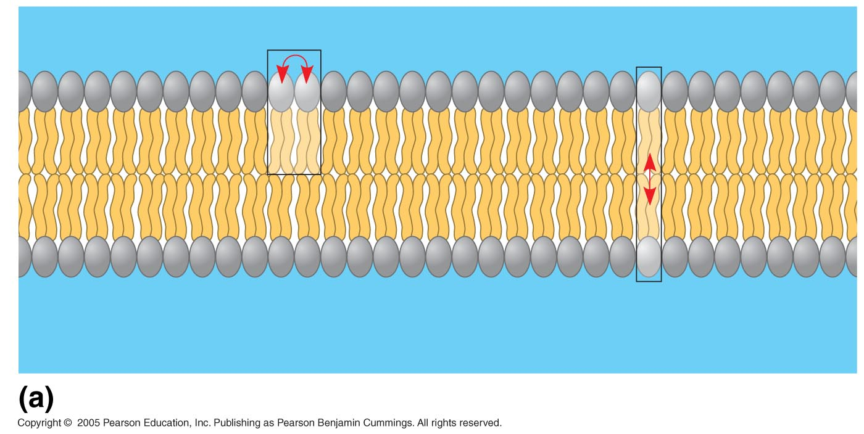
Fluidity of the membrane:
Most of the lipids and some proteins drift laterally
Much rarer do they flip-flop across the membrane
Must be fluid to work properly; usually about as fluid as salad oil
Lateral movement
(~10⁷ times per second)
Flip-flop
(~ once per month)
Movement of phospholipids
Notes:
As temperatures cool, membranes switch from a fluid state to a solid state

Slide 7
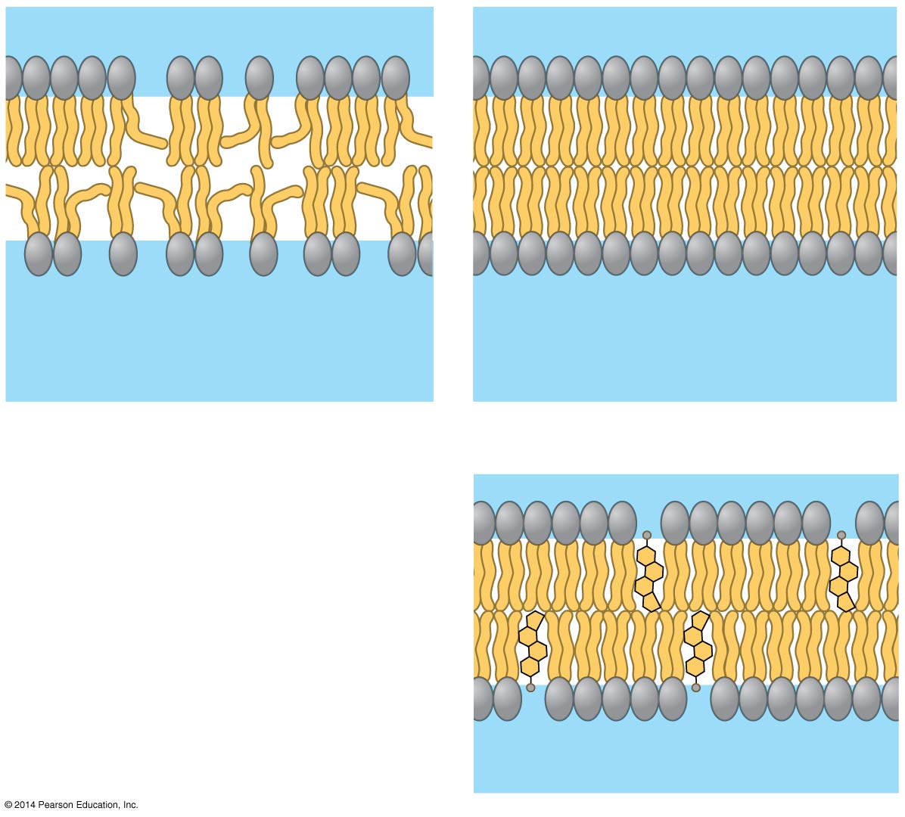
Factors that affect fluidity
Fluid
Viscous
Unsaturated tails prevent
packing.
Saturated tails pack
together.
(a) Unsaturated versus saturated hydrocarbon tails
(b) Cholesterol reduces
membrane fluidity at
moderate temperatures,
but at low temperatures
hinders solidification.
Cholesterol
Notes:
7
Membranes rich in unsaturated fatty acids are more fluid than those rich in saturated fatty acids

Slide 8
Membrane Proteins and Their Functions
A membrane is a collage of different proteins embedded in the fluid matrix of the lipid bilayer
Proteins determine most of the membrane’s specific functions
Peripheral proteins are not embedded
Integral proteins penetrate the hydrophobic core and often span the membrane

Slide 9
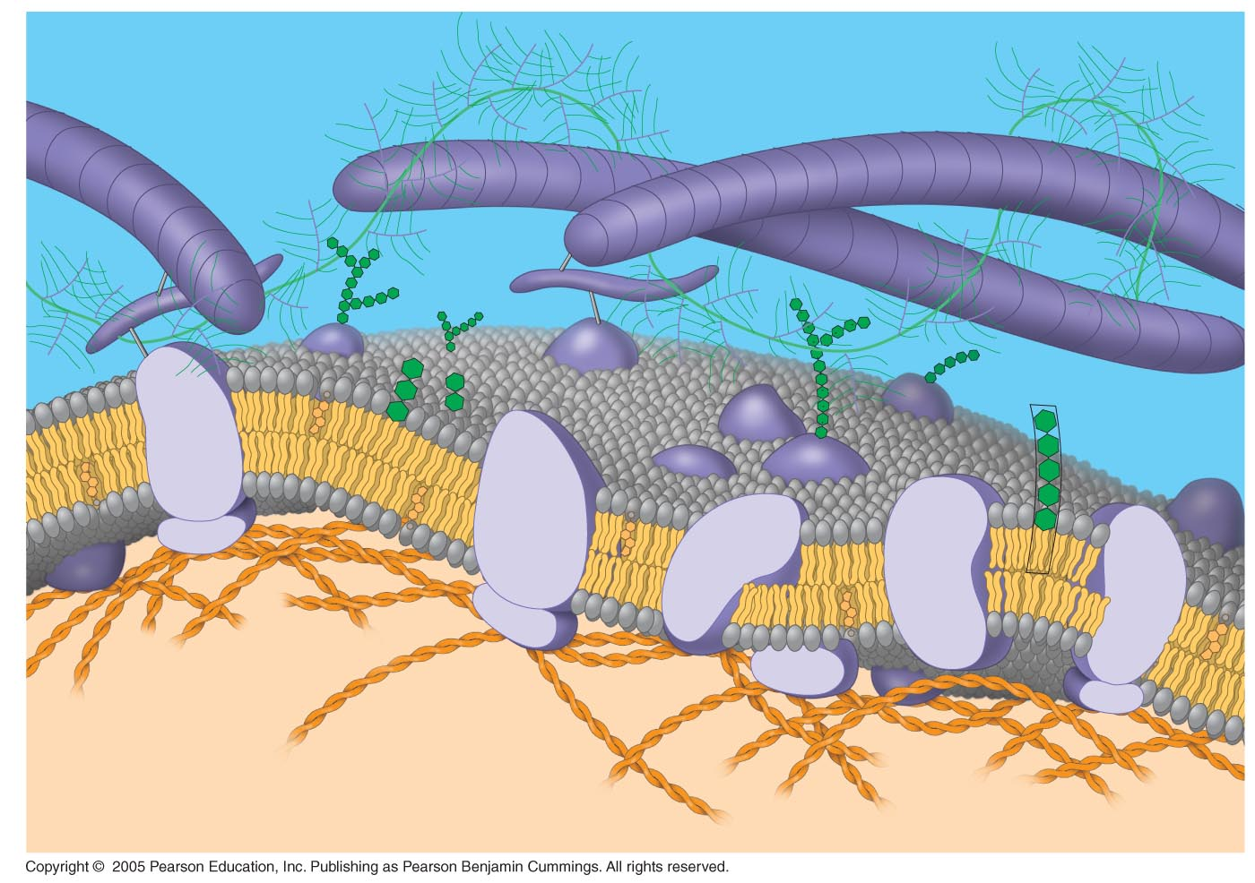
Fibers of
extracellular
matrix (ECM)
Glycoprotein
Carbohydrate
Glycolipid
EXTRACELLULAR
SIDE OF
MEMBRANE
Cholesterol
Microfilaments
of cytoskeleton
Peripheral
proteins
Integral
protein
CYTOPLASMIC SIDE
OF MEMBRANE

Slide 10
The Permeability of the Lipid Bilayer
Hydrophobic (nonpolar) molecules, such as hydrocarbons, can dissolve in the lipid bilayer and pass through the membrane rapidly
Polar molecules, such as sugars, do not cross the membrane easily

Slide 11
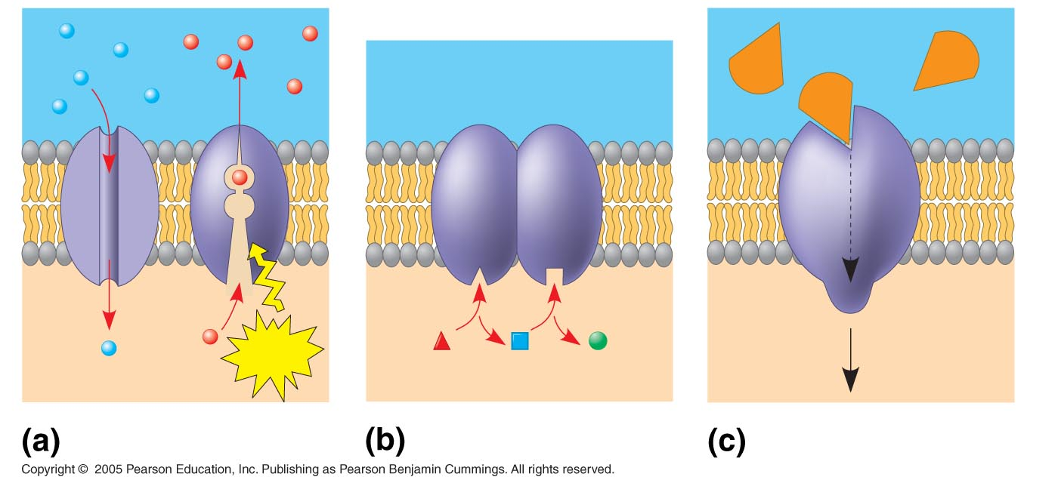
Major functions of membrane proteins:
Signal
Enzymes
Receptor
ATP
Transport
Enzymatic activity
Signal transduction

Slide 12
Transport Proteins
Transport proteins allow passage of hydrophilic substances across the membrane
Some transport proteins, called channel proteins, have a hydrophilic channel that certain molecules or ions can use as a tunnel
Other transport proteins, called carrier proteins, bind to molecules and change shape to shuttle them across the membrane
A transport protein is specific for the substance it moves

Slide 13
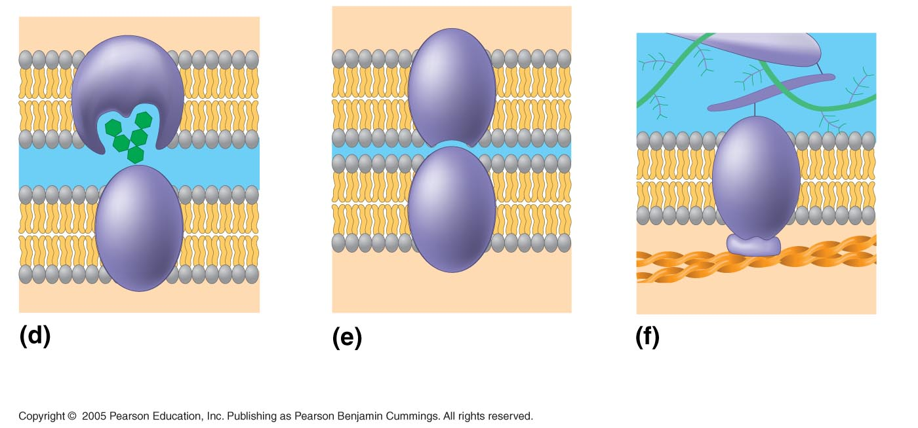
Glyco-
protein
Attachment to the
cytoskeleton and extra-
cellular matrix (ECM)
Cell-cell recognition
Intercellular joining
Cells recognize each other by binding to surface molecules, often carbohydrates, on the plasma membrane
Notes:
Membrane carbohydrates may be covalently bonded to lipids (forming glycolipids) or more commonly to proteins (forming glycoproteins)

Slide 14
Passive transport: is diffusion of a substance across a membrane with NO ENERGY investment
Diffusion is the tendency for molecules to spread out evenly into the available space, down a concentration gradient
Although each molecule moves randomly, diffusion of a population of molecules may exhibit a net movement in one direction
At dynamic equilibrium, as many molecules cross one way as cross in the other direction

Slide 15
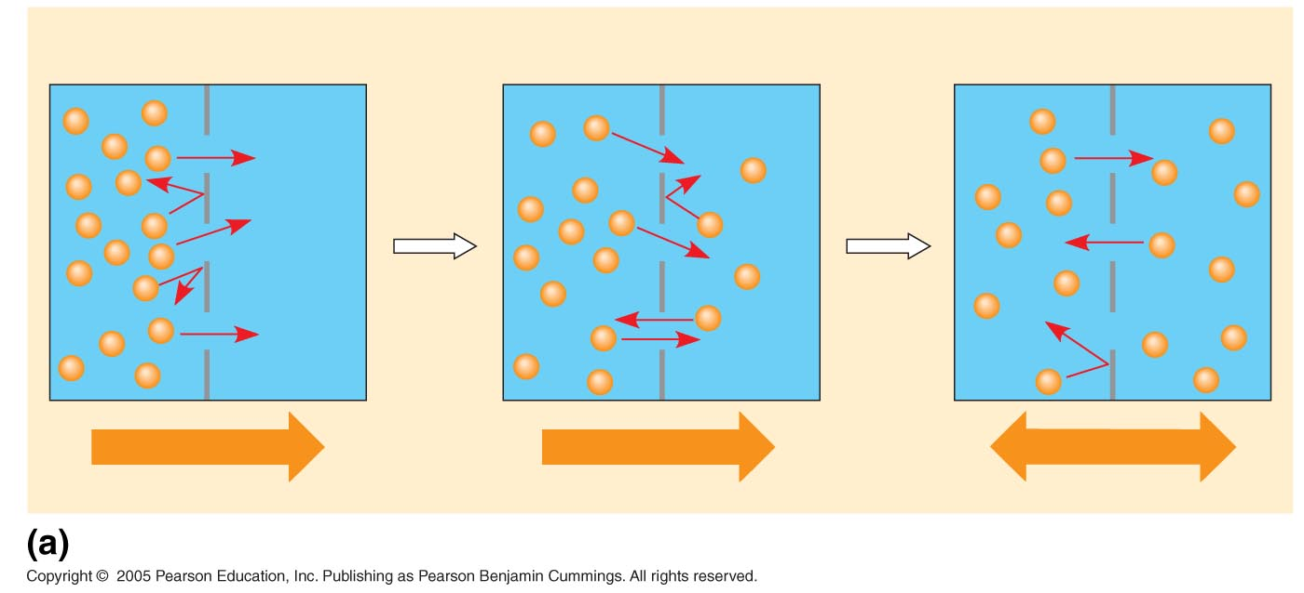
Molecules of dye
Membrane (cross section)
WATER
Net diffusion
Net diffusion
Equilibrium
Diffusion of one solute

Slide 16
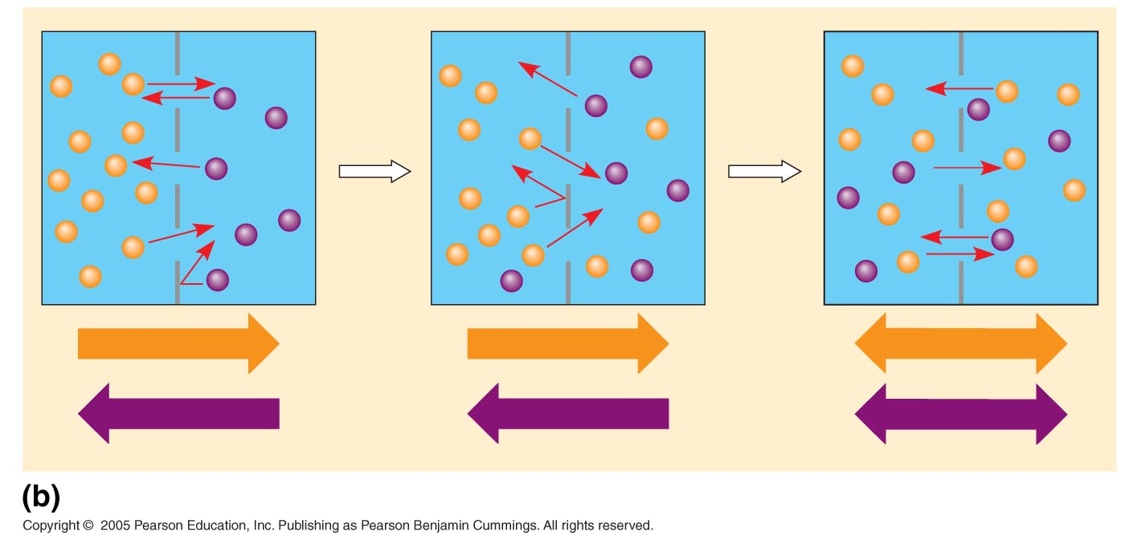
Net diffusion
Net diffusion
Equilibrium
Net diffusion
Net diffusion
Equilibrium
Diffusion of two solutes

Slide 17
Facilitated Diffusion: Passive Transport Aided by Proteins
In facilitated diffusion, transport proteins speed movement of molecules across the plasma membrane
Channel proteins provide corridors that allow a specific molecule or ion to cross the membrane
Carrier proteins undergo a subtle change in shape that translocates the solute-binding site across the membrane

Slide 18
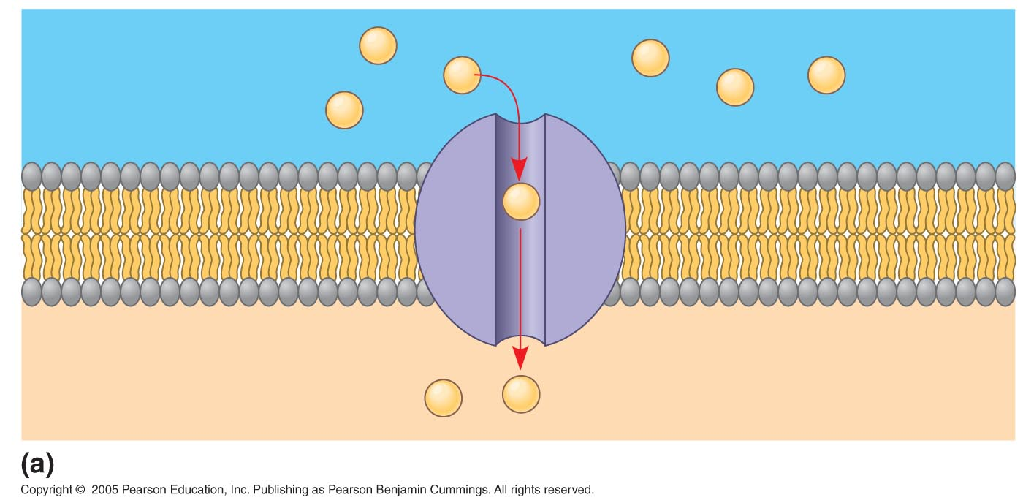
EXTRACELLULAR
FLUID
Channel protein
Solute
CYTOPLASM

Slide 19
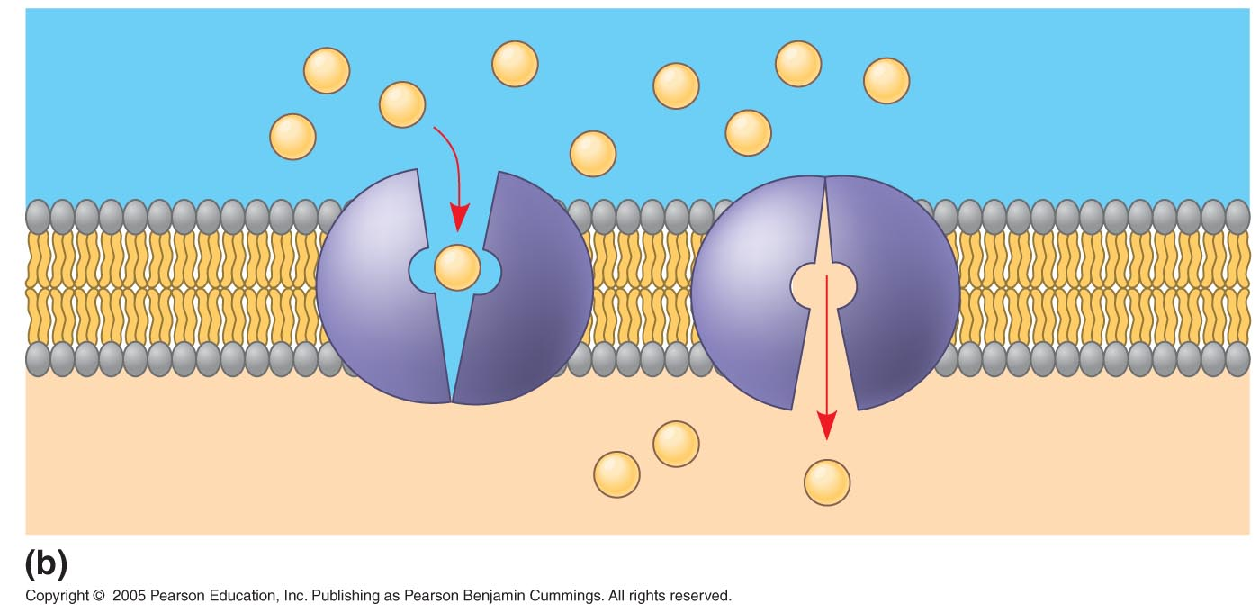
Carrier protein
Solute

Slide 20
Active transport:
Active transport moves substances against their concentration gradient
Active transport requires energy, usually in the form of ATP
Active transport is performed by specific proteins embedded in the membranes
The sodium-potassium pump is one type of active transport system

Slide 21
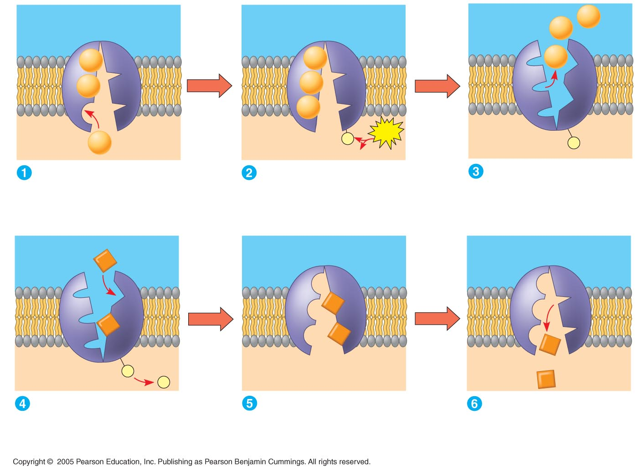
EXTRACELLULAR
FLUID
[Na⁺] high
[K⁺] low
Na⁺
Na⁺
Na⁺
Na⁺
Na⁺
Na⁺
Na⁺
Na⁺
[Na⁺] low
[K⁺] high
P
ATP
CYTOPLASM
Na⁺
P
ADP
Cytoplasmic Na⁺ bonds to
the sodium-potassium pump
Na⁺ binding stimulates
phosphorylation by ATP.
Phosphorylation causes
the protein to change its
conformation, expelling Na⁺
to the outside.
K⁺
K⁺
K⁺
K⁺
K⁺
P
K⁺
P
Extracellular K⁺ binds
to the protein, triggering
release of the phosphate
group.
Loss of the phosphate
restores the protein’s
original conformation.
K⁺ is released and Na⁺
sites are receptive again;
the cycle repeats.

Slide 22
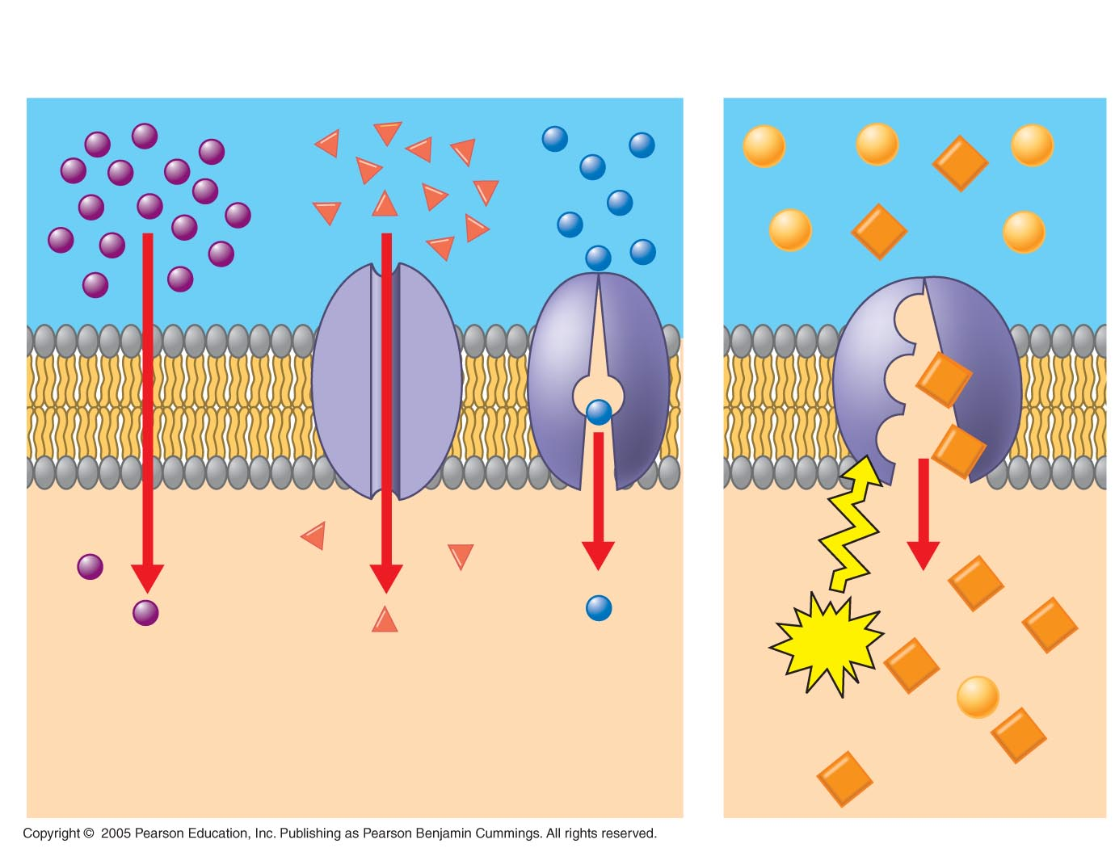
Passive transport
Active transport
ATP
Diffusion
Facilitated diffusion

Slide 23
Cotransport: Coupled Transport by a Membrane Protein
Cotransport occurs when active transport of a solute indirectly drives transport of another solute
Plants commonly use the gradient of hydrogen ions generated by proton pumps to drive active transport of nutrients into the cell

Slide 24
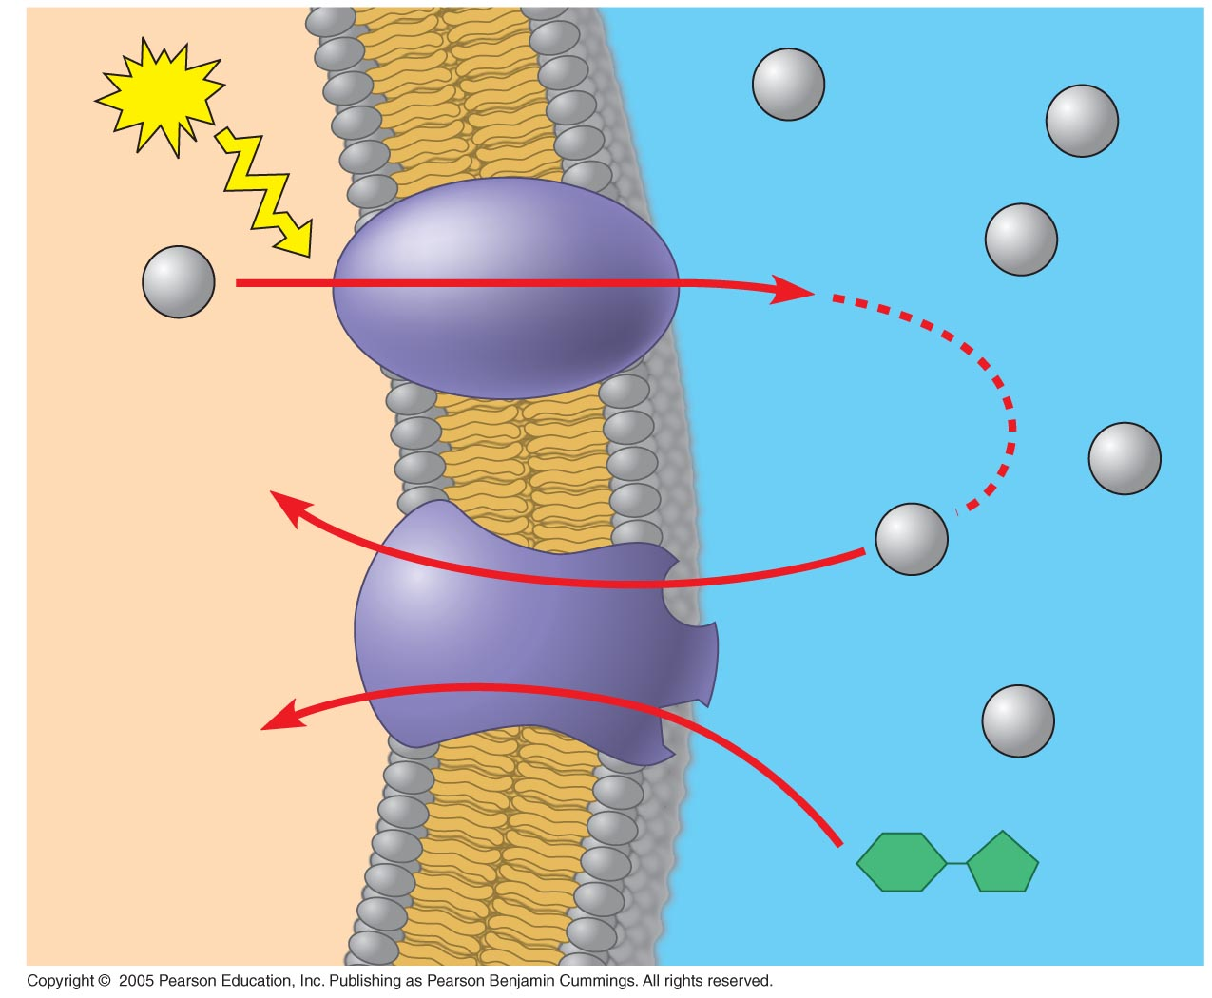
–
+
ATP
H⁺
H⁺
–
+
Proton pump
H⁺
H⁺
–
+
–
H⁺
+
H⁺
Diffusion
of H⁺
Sucrose-H⁺
cotransporter
H⁺
–
+
–
+
Sucrose

Slide 25
Bulk transport across the plasma membrane occurs by exocytosis and endocytosis
Small molecules and water enter or leave the cell through the lipid bilayer or by transport proteins
Large molecules, such as polysaccharides and proteins, cross the membrane via vesicles

Slide 26
Exocytosis
In exocytosis, transport vesicles migrate to the membrane, fuse with it, and release their contents
Many secretory cells use exocytosis to export their products

Slide 27
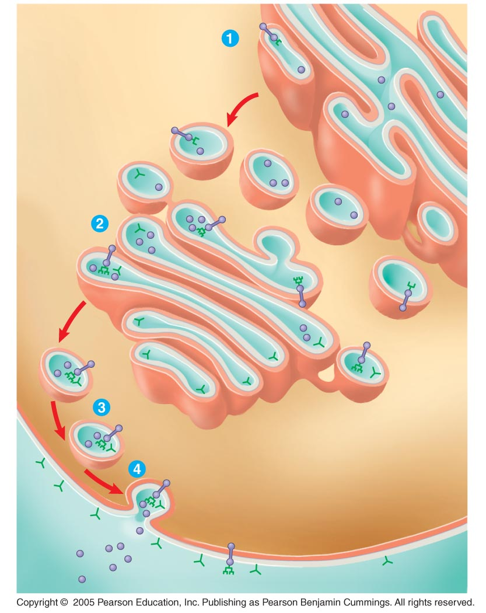
ER
Transmembrane
glycoproteins
Secretory
protein
Glycolipid
Golgi
apparatus
Vesicle
Plasma membrane:
Cytoplasmic face
Extracellular face
Transmembrane
glycoprotein
Secreted
protein
Plasma membrane:

Slide 28
Endocytosis
In endocytosis, the cell takes in macromolecules by forming vesicles from the plasma membrane
Endocytosis is a reversal of exocytosis, involving different proteins – this requires energy!

Slide 29
Three types of endocytosis:
Phagocytosis (“cellular eating”): Cell engulfs particle in a vacuole
Pinocytosis (“cellular drinking”): Cell creates vesicle around fluid
Receptor-mediated endocytosis: Binding of ligands to receptors triggers vesicle formation

Slide 30
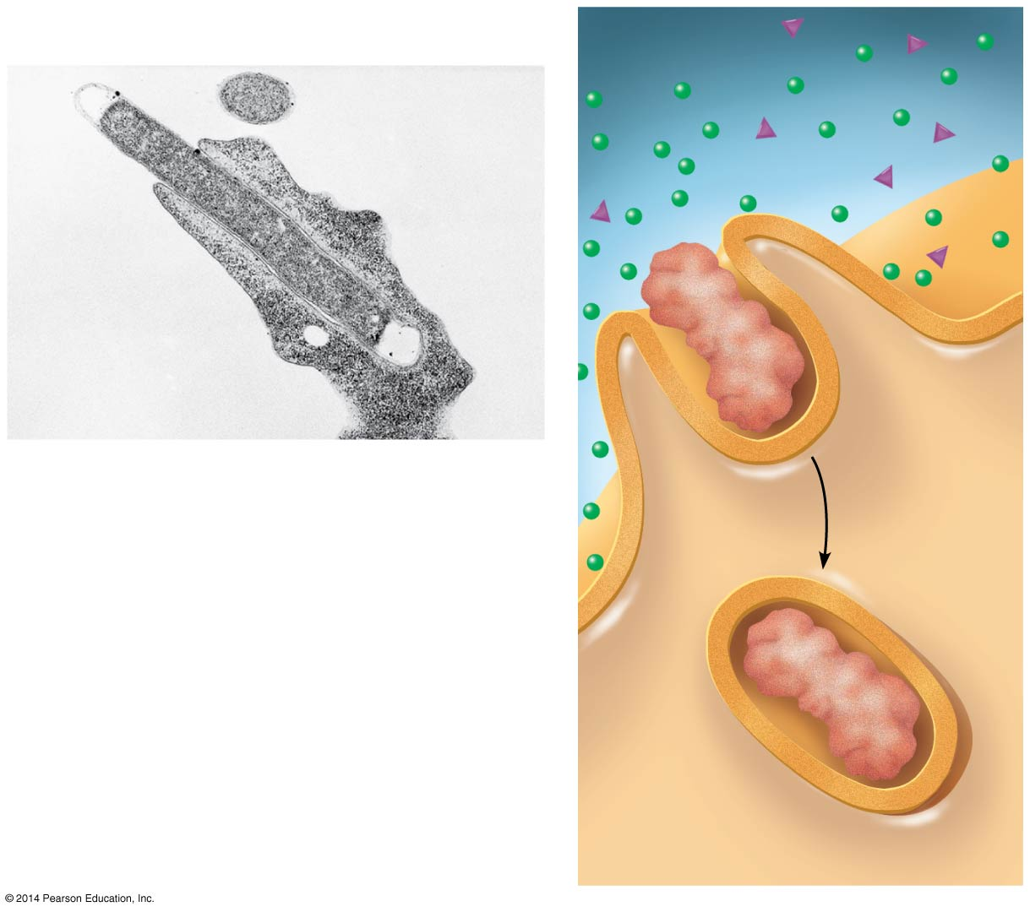
Phagocytosis
EXTRACELLULAR
FLUID
Pseudopodium
of amoeba
Solutes
Pseudopodium
Bacterium
1 μm
Food vacuole
“Food”
or other
particle
An amoeba engulfing a bacterium
via phagocytosis (TEM)
Food
vacuole
CYTOPLASM
Notes:
30
Figure 5.18a Exploring endocytosis in animal cells (part 1: phagocytosis)

Slide 31
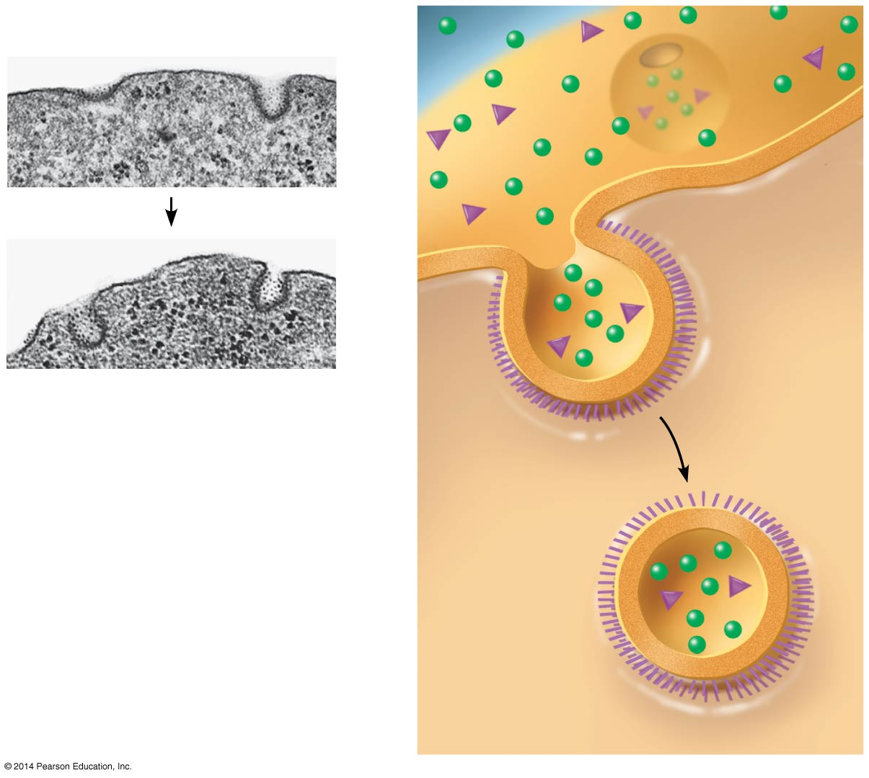
Pinocytosis
Plasma
membrane
0.25 μm
Coat
protein
Pinocytotic vesicles forming
(TEMs)
Coated
pit
Coated
vesicle
Notes:
31
Figure 5.18b Exploring endocytosis in animal cells (part 2: pinocytosis)

Slide 32
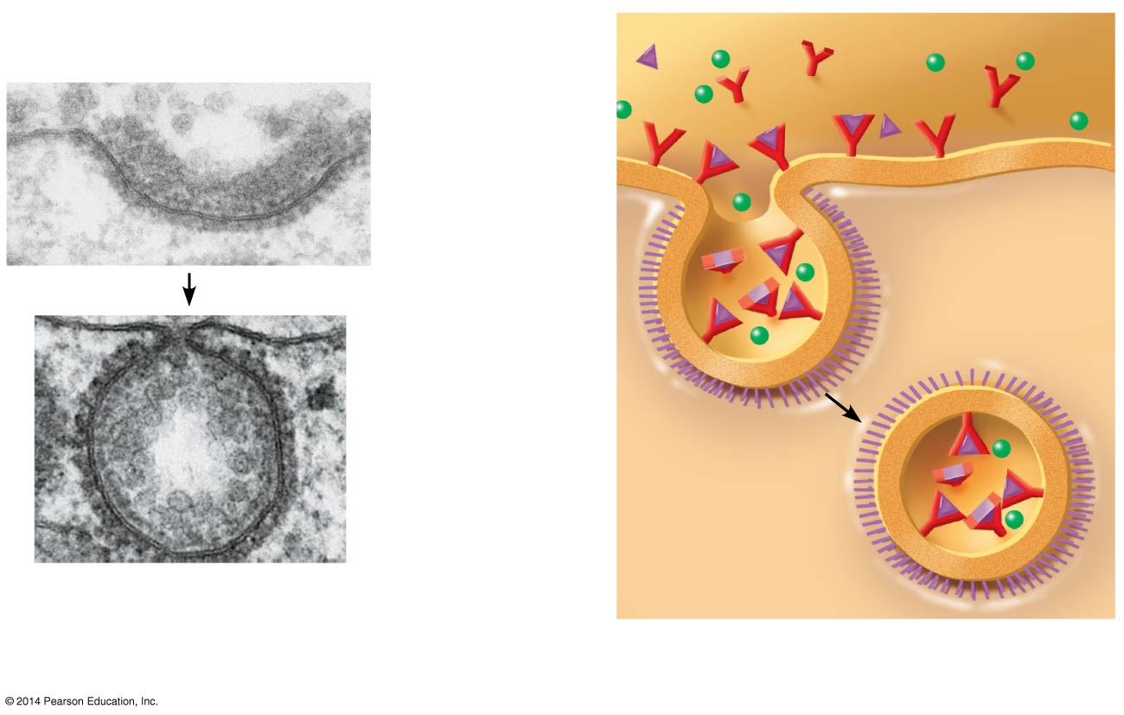
Receptor-Mediated
Endocytosis
Plasma
membrane
Coat
protein
Receptor
0.25 μm
Top: A coated pit Bottom: A coated
vesicle forming during receptor-
mediated endocytosis (TEMs)
Notes:
32
Figure 5.18c Exploring endocytosis in animal cells (part 3: receptor-mediated endocytosis)

Slide 33
PHEW THAT WAS A LOT

