Slide 1
The Eye
SNC2D

Slide 2
Anatomy of the Eye

Slide 3
Sclera
The white part of the eyeball is called the sclera (say: sklair-uh). The sclera is made of a tough material and has the important job of covering most of the eyeball. Think of the sclera as your eyeball's outer coat.

Slide 4
Look very closely at the white of the eye, and you'll see lines that look like tiny pink threads. These are blood vessels, the tiny tubes that deliver blood, to the sclera.

Slide 5
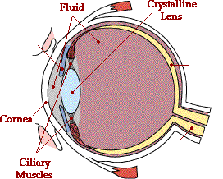
The Anatomy of the Eye
Light entering the eye first meets the cornea, a thin protective membrane (refractive index 1.38); it passes through fluid to the crystalline lens (1.44), the shape of which can be adjusted by the ciliary muscles.

Slide 6
The Anatomy of the Eye
Unlike the rest of the sclera, which is white, the cornea is transparent, or completely clear, which lets light travel through it. Like clear glass, the cornea gives your eye a clear window to view the world through

Slide 7
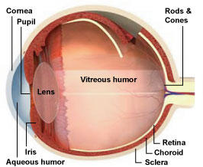
IRIS
Behind the cornea are the iris and the pupil. The iris (say: eye-riss) is the colorful part of the eye. When we say a person has blue eyes, we really mean the person has blue irises!

Slide 8
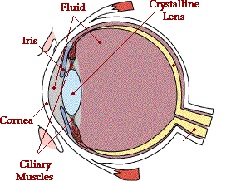
The Anatomy of the Eye
The iris is a muscle.The amount of light entering the eye can be controlled by the iris (the coloured part of the eye) which can dilate to admit more light.
What about the black part of the eye?

Slide 9
The Anatomy of the Eye
The black part of the eye, or the pupil, is not a proper anatomical part of the eye. It is just the opening for the light and appears black because all incident light is absorbed and not reflected back at the observer.

Slide 10
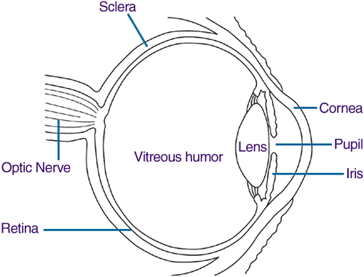
Between the iris and cornea is the anterior (say: an-teer-ee-ur) chamber. This chamber is filled with a special transparent fluid that gives the eye oxygen, protein, and glucose (a type of sugar in the body) to keep it healthy. The liquid in this space is called the Aqueous Humor

Slide 11
After light enters the pupil, it hits the lens. The lens sits behind the iris and is clear and colorless. The lens' job is to focus light rays on the back of the eyeball - a part called the retina (say: reh-tin-uh).

Slide 12
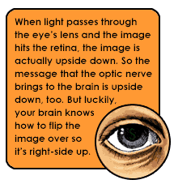

Slide 13
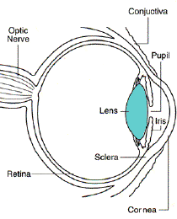
The lens
The human eye can change the shape of the lens automatically.
The range of change that the lens can accomplish varies from person to person.

Slide 14
VITREOUS BODY
The biggest part of the eye sits behind the lens and is called the vitreous (say: vih-tree-us) body. The vitreous body forms two thirds of the eye's volume and gives the eye its shape. It's filled with a clear, jelly-like material called the vitreous humor. Ever touch toy eyeballs in a store? Sometimes they're kind of squishy - that's because they're made to feel like they're filled with vitreous humor. In a real eye, after light passes through the lens, it shines straight through the vitreous humor to the back of the eye.

Slide 15
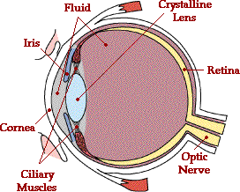
The Anatomy of the Eye
At the back of the eye is the retina, the “screen” on which images are formed. Its rods and cones detect the intensity and frequency of light and send the information to the brain via the optic nerve.

Slide 16
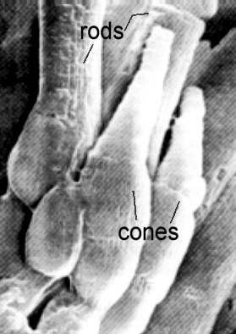
Rods and Cones
Rods are more sensitive to light and dark changes, shape, and movement but contain only one type of light-sensitive pigment and are therefore not good for color vision. Rods are more numerous than cones in the periphery of the retina.

Slide 17
The Periphery of Vision
Hold your arm out to your side far enough back that you can only just see the movement of your fingers out of the corner of your eye when looking forward.
Have a friend place an object such as a pen in your hand. Can you tell what colour it is while still looking forward?

Slide 18
Rods and Cones
Cones are most sensitive to one of three different colours (green, red or blue). Signals from the cones are sent to the brain which then translates these messages into the perception of colour. Cones, however, are not as sensitive to light as rods. That's why you cannot see colour very well in dark places.

Slide 19
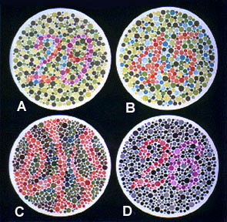
Colour Blindness
Someone who is colour blind does not have a particular type of cone in the retina or one type of cone may be weak. In the general population, about 8% of all males are color blind and about 0.5% of all females are color blind.

Slide 20
The Blind Spot
Note that because the optic nerve runs through the retina, there is a “blind spot” on the retina, also called the optic disc. Light that falls on this area will not be detected.

Slide 21
The Blind Spot
To find your blind spot, look at the following image on a piece of paper:
Close your left eye. Hold the image about 20 inches away. With your right eye, look at the dot. Slowly bring the image closer while looking at the dot. At a certain distance, the + will disappear from sight . . . this is when the + falls on the blind spot of your retina.
Repeat for the other eye, looking at the + instead.

Slide 22
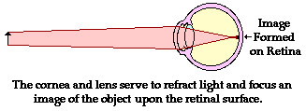
Image Formation
Most refraction actually occurs in the cornea because the index of refraction of the cornea is significantly different than the index of refraction of air. The changing-shape lens fine-tunes the refraction. Together, both act as a converging lens with a focal length of approximately

Slide 23
Image Formation
Most refraction actually occurs in the cornea because the index of refraction of the cornea is significantly different than the index of refraction of air. The changing-shape lens fine-tunes the refraction. Together, both act as a converging lens with a focal length of approximately 1.7 cm.

Slide 24
Image Formation
Note that the image formed on the retina will be real, smaller, and inverted.
It is the brain that is responsible for re-inverting the image when it is interpreted.

Slide 25
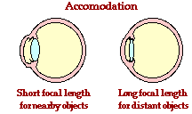
Accommodation
However, since the image distance, d_{i}, is fixed, the focal length, f, must change to focus objects at different distances, d_{o}. The focal length is changed by the ciliary muscles changing the shape of the lens.

Slide 26
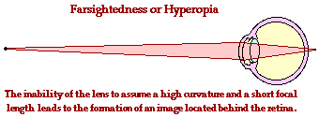
Farsightedness
The inability of an eye to focus on near objects (usually because of either a failure of the ciliary muscles or decreased flexibility of the lens) is called farsightedness or hyperopia.

Slide 27
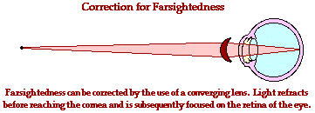
Farsightedness
The inability of an eye to focus on near objects (usually because of either a failure of the ciliary muscles or decreased flexibility of the lens) is called farsightedness or hyperopia.

Slide 28
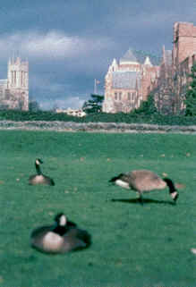
Notice the geese are blurry but the city is clear.

Slide 29
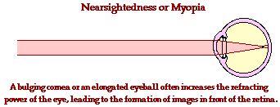
Nearsightedness
The inability of an eye to focus on far objects (usually because of an elongated eyeball) is called nearsightedness or myopia.

Slide 30
Nearsightedness
The inability of an eye to focus on far objects (usually because of an elongated eyeball) is called nearsightedness or myopia.

Slide 31
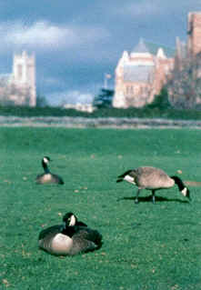
Notice geese are clear but the city is blurry.

Slide 32
Eye Glasses
To correct this fuzzy vision, many people, including many kids, wear glasses. Glasses help the eyes focus images correctly on the retina and allow someone to see clearly. As adults get older, their eyes change shape and they often need glasses to see things up close or far away. Most older people you know - like your grandparents - probably wear glasses.

Slide 33
